Slide 1
Slot & Filler Structure
Monotonic/ nonmonotonic inferences can be performed more efficiently with these structures than with pure logic
Inheritance is easy because knowledge in slot and filler systems is structured as a set of entities and their attributes.
It indexes assertions by the entities they describe. As a result, retrieving the value for an attribute of an entity is fast.
It make easy to describe properties of relations. To do this in a purely logical system requires higher-order mechanisms.

Slide 2
Weak Slot & Filler Structure
It is a form of object-oriented programming and has the advantages that such systems normally have, including modularity and ease of viewing by people.
We will discuss two things - Semantic Nets & Frames

Slide 3
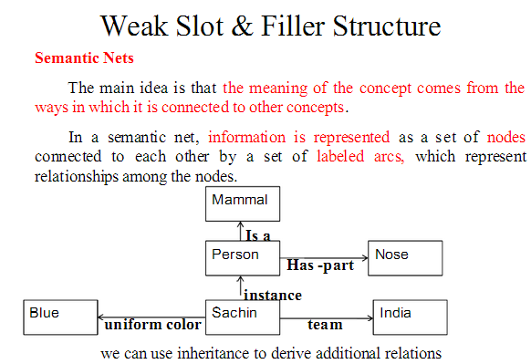

Slide 4
Semantic Nets
Intersection Search
We try to find relationships among objects by spreading activation out from each of two nodes and seeing where the activation meets. Using this we can answer the questions like - what is the relation between India and Blue.
It takes advantage of entity based organization of knowledge that slot and filler representation provide.
Represent Non-binary Predicates
Simple binary predicates like isa(Person, Mammal) can be represented easily by semantic nets but other non binary predicates can also be represented by using general-purpose predicate such as isa and instance.

Slide 5
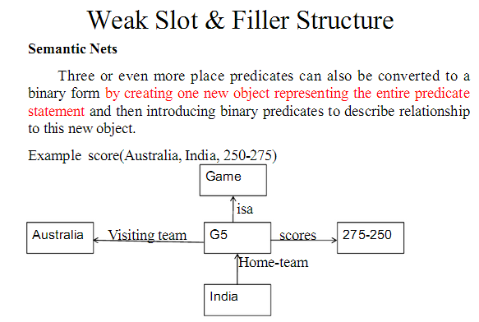

Slide 6
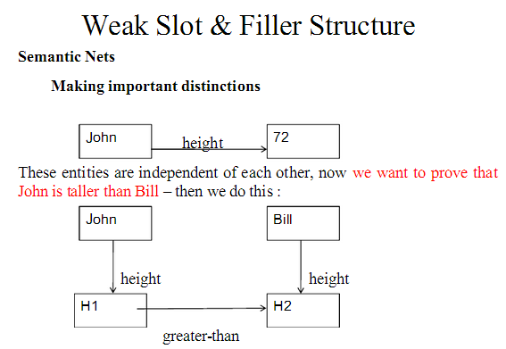

Slide 7
Semantic NETs

Slide 8
Semantic Nets
Partitioned Semantic Nets
To represent simple quantified expressions in semantic nets partitioned semantic network is used. It can be done with the help of partitioning the semantic net into a hierarchical set of spaces, each of which corresponds to the scope of one or more variable.
Eg. - The dog bit the mail carrier.
This is simple and can be easily represented. Every dog has bitten a mail carrier.
Every dog has bitten every mail carrier.

Slide 9
Partitioned Semantic Nets
To represent quantifiers, it is necessary to encode the scope of the universally quantified variable. x This can be done using partitioning net.
Node is an instance of the special class GS of general statements about the world (i.e., those with universal quantifiers).
Every element of GS has at least two attributes: a form, which states the relation that is being asserted, and one or more connections. One for each of the universally quantified variables.

Slide 10
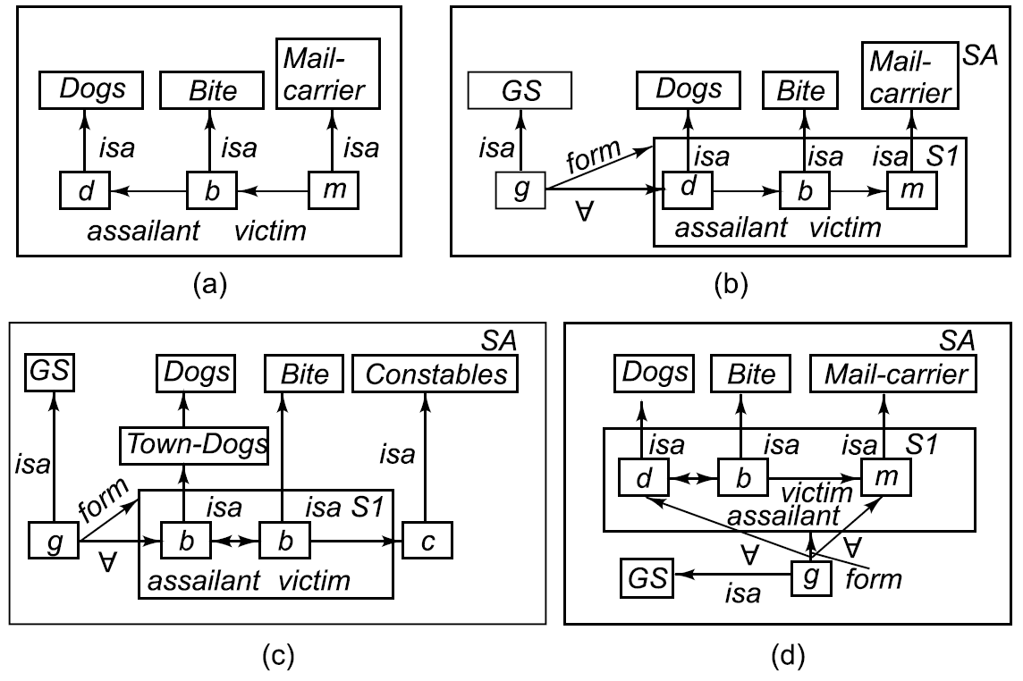
Partitioned Semantic Nets
The dog bit the mail carrier.
Every dog has bitten a mail carrier.
Every dog in town has bitten the constable:
Every dog has bitten every mail carrier.

Slide 11
Partitioned Semantic Nets
Every dog in town has bitten the constable.
The node c representing the victim lies outside the form of the general statement. Thus it is not viewed as an existentially quantified variable whose value may depend on the value of d. Instead it is interpreted as standing for a specific entity (in this case, a particular constable), just as do other nodes in a standard, nonpartitioned net.
The spaces of a partitioned semantic net are related to each other by an inclusion hierarchy. In Fig., space SI is included in space SA. Whenever a search process operates in a partitioned semantic net, it can explore nodes and arcs in the space from which it starts and in other spaces that contain the starting point, but it cannot gdownward, except in special circumstances, such as when a form are is being traversed.

Slide 12
Partitioned Semantic Nets
From node d it can be determined that d must be a dog. But if we were to start at the node Dogs and search for all known instances of dogs by traversing isa links, we would not find d since
it and the link to it are in the space SI, which is at a lower level than space SA. Which contains Dogs. This is
important, since d does not stand for a particular dog; it is merely a variable that can be instantiated with a value that represents a dog.

Slide 13
Semantic Nets
Evolution of Frames
As seen in the previous problem, there are problems which are difficult to solve with Semantic Nets. Although there is no clear distinction between a semantic net and frame system. The more structured the system has, the more likely it is to be termed a frame system.

Slide 14
Frames
A frame is a collection of attributes (called slots) and associated values that describe some entity in the world.
Sometimes a frame describes an entity in some absolute sense, sometimes it represents the entity from a particular point of view only.
A single frame taken alone is rarely useful, we build frame systems out of collections of frames that are connected to each other by virtue of the fact that the value of an attribute of one frame may be another frame.

Slide 15
A Simplified Frame System

Slide 16
Frames as Sets and Instances
The set theory is a good basis for understanding frame systems. Each frame represents either a class ( a set) or an instance ( an element of class)
Considering the Cricket example-
Person, Adult Male, Bowler, Team are all classes. Player name and country name are entities.
Both isa and instance relations have inverse attributes, which we call subclasses & all-instances.
A class represents a set, there are 2 kinds of attributes that can be associated with it.
Its own attributes & Attributes that are to be inherited by each element of the set.(* - This is how they are represented.)

Slide 17
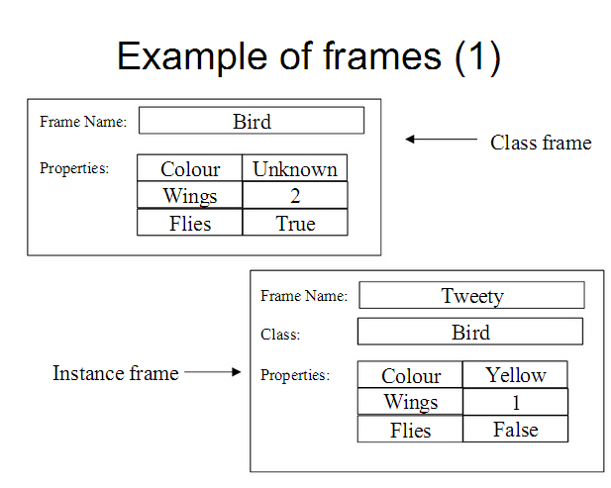

Slide 18
Frames as Sets and Instances
Sometimes, the difference between a set and an individual instance may not be clear.
Example - Team India is an instance of class of Cricket Teams and can also be thought of as set of players.
Now the problem is if we represent Team India as a sub class of Cricket teams, then indian players automatically become part of all the teams, which is not true. We have to do something to stop this. Instead we can make Team India a sub class of class called Cricket Players.
To do this we need to differentiate between regular classes and metaclasses.
Regular Classes are those whose elements are individual entities.
Metaclasses are those special classes whose elements are themselves classes.

Slide 19
Frames as sets and instances
The most basic meta class is the class CLASS. It represents the set of all classes.
All classes are instances of it, either directly or through one of its subclasses.
The class CLASS introduces the attribute cardinality, which is to be inherited by all instances of CLASS.
Cardinality stands for number.

Slide 20
Other ways of relating classes to each other
We have discussed that
A class1 can be a subclass of class2.
If Class2 is a meta class then Class1 can be an instance of Class2.
Another way is -mutually-disjoint-with relationship, which relates a class to one or more other classes that are guaranteed to have no elements in common with it.
Another one is - is-covered-by which relates a class to a set of subclasses, the union of which is equal to it.
If a class is-covered-by a set S of mutually disjoint classes, then S is called a partition of the class.

Slide 21
Slots as full-fledged objects(frames)
Till now we have used attributes as slots, but now we will like to represent attributes explicitly and describe their properties.
Some of the properties we would like to be able to represent and use in reasoning include:
The class to which the attribute can be attached
Constraints on either the type or the value of the attribute.
A default value for the attribute.
Rules for inheriting values for the attribute.

Slide 22
Slots as full –fledged objects(frames)
To be able to represent attributes of attributes, we need to describe attributes(slots) as frames.
These frames will be organized into an isa hierarchy, just as any other frames are, and that hierarchy can then be used to support inheritance of values for attributes of slots.
Slot -A slot here is talked about as a relation. It maps from elements of its domain (the classes for which it makes sense) to elements of its range(its possible values). A relation is a set of ordered pairs.
If relation R1 is a subset of another R2.In that case R1 is a specialization of R2.
Since a slot is a set, the set of all slots, which we will call SLOT, is a meta class. Its instances are slots, which may have sub slots.

Slide 23
Slots values as objects
In the last section, we have used slots as explicit object that we could make assertions about.
Here, we will discuss about using slot “values” as objects.
Let’s take the following example
John:
height:72
Bill:
height:
The only information we have here is that John is taller than Bill.

Slide 24
SLOTS VALUES AS OBJECTS
We need to make an statement about the value of a slot without knowing what the value is. To do that, we need to view the slot and its value as an object.
We will expand our representation language to allow the value of slot to be stated as either or both of :
A value of the type required by the slot.
A logical constraint on the value. The constraint may relate the slot’s value to the values of other slots or to domain constants

